Slide 1
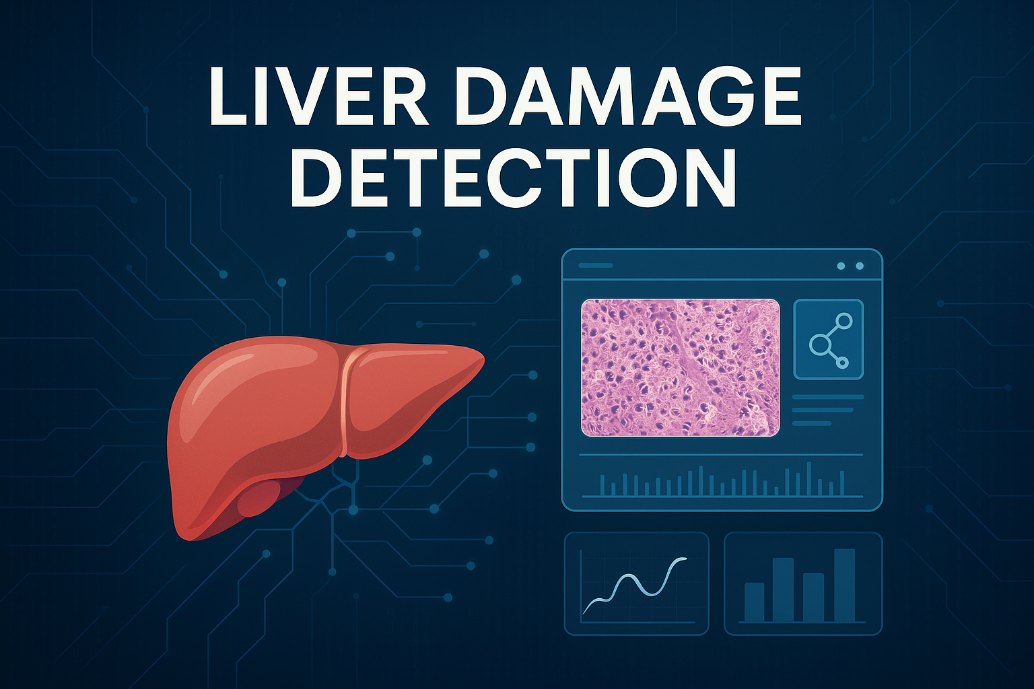


Slide 2

CONTENTS
BUSINESS PROBLEM
BUSINESS OBJECTIVE
BUSINESS CONSTRAINTS
BUSINESS SUCCESS CRITERIA
PROJECT WORKFLOW
PROJECT ARCHITECTURE
DATA COLLECTION
DATA PREPROCESSING
PROJECT CHALLENGES
CONCLUSION

Slide 3
BUSINESS PROBLEM
Current liver damage detection relies heavily on manual analysis by hepatologists, making early diagnosis and risk assessment time-consuming and prone to human error. By leveraging Al-driven models to analyze histopathology images and patient healthcare data, we can provide detailed insights to assist hepatologists in making more accurate and timely decisions for early intervention.

Slide 4
BUSINESS OBJECTIVE:
Maximize early detection accuracy.
BUSINESS CONSTRAINT:
Minimize false positive/negative rates.

Slide 5
SUCCESS CRITERIA: Business Success Criteria: Reduce manual efforts in liver damage assessment by 20-30% through Al- driven insights. ML Success Criteria: Achieve a prediction accuracy more than 85% in detecting liver damage. Economic Success Criteria: Achieve at least a 15% cost reduction in diagnosis by minimizing errors and optimizing workflows.

Slide 6
PROJECT WORKFLOW
IMAGE COLLECTION
EDA
DATA PREPROCESSING
MODEL BUILDING
MODEL EVALUATION
DEPLOYMENT
MONITORING & MAINTENANCE

Slide 7
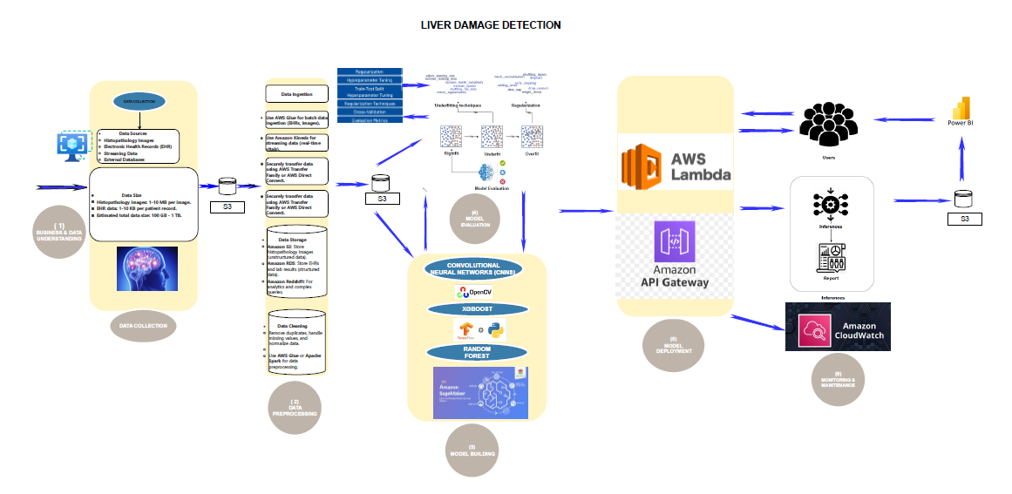
PROJECT ARCHITECTURE-HIGH LEVEL

Slide 8
IMAGE COLLECTION

Slide 9
📊 1. STATISTICAL & DATA ANALYTICS OVERVIEW 1.1 Data Summary Source: Manually Collected Histopathology image dataset because desired Dataset is not available in Kaggle and other sites. Volume: HCC (Hepatocellular Carcinoma): 79 images CC (Cholangiocarcinoma): 170 images NORMAL LIVER: 21 images Total Dataset Size: 161 MB 1.2 Target Variable Multiclass Classification: Class 0: NORMAL LIVER Class 1: HCC Class 2: CC

Slide 10
EDA

Slide 11
📊 EDA Insights
1. Class Distribution
All samples in the given snippet belong to the 'CC' class.
✅ Action: Check full dataset later to ensure all classes (CC, HCC, NORMAL) are balanced.
2. Image Size (Width & Height)
Width Range: 685 px to 2448 px
Height Range: 451 px to 1920 px
Images have large variation in size.
✅ Action: Consider resizing images to a consistent size before model training.

Slide 12
3. Aspect Ratio Aspect Ratio Range: 1.27 to 1.68 Most images are wider than tall (Aspect Ratio > 1). ✅ Action: Maintain aspect ratio if resizing to avoid image distortion.
4. Intensity Analysis
Mean Intensity varies from ~136 to ~184.
Median Intensity is generally higher than mean in most cases → slight right skew in pixel intensity distribution.
Mode Intensity varies a lot: values like 0, 171, 201 seen.Mode 0 suggests presence of black or very dark regions in some images.

Slide 13
DATA PREPROCESSING

Slide 14
-Each original image undergoes the following 10 transformations: (1) Filtered – Gaussian Blur (2) Shifted – Translation (30 pixels right & down) (3) Cropped – 20 pixels removed from all sides (4) Padded – 20 pixels black border added (5) Normalized – Scaled pixel values to [0, 1] (then rescaled for saving) (6) Augmented – Using ImageDataGenerator (1 random augmented image) (7) Rotated 90° – Clockwise rotation (8) Transposed – Diagonal flip (cv2.transpose) (9) H-Flip – Horizontal flip (10) V-Flip – Vertical flip
📌DATA AUGMENTATION & PREPROCESSING STEPS

Slide 15
3.1📊 Original Dataset Summary
Class | Original Count
HCC | 79 images
CC | 170 images
NORMAL LIVER | 21 images
Total | 270 images
3.2📈 Augmented Dataset Summary (After 10 Transformations per Image)
Each original image generates 10 new transformed images, so:
Class | Transformed Count | Total (Original + Augmented)
HCC | 79 × 10 = 790 | 869 images
CC | 170 × 10 = 1700 | 1870 images
NORMAL LIVER | 21 × 10 = 210 | 231 images
Total | 2700 | 2970 images

Slide 16
💾 Estimated Dataset Size Original Size = 161 MB (270 images) After Augmentation (~10x) = ~1.6 GB (2970 images)
⚠️ Issue Identified:
Normal Liver had too few samples (231) even after augmentation.
🔧 Solution Applied:
further augmented Normal Liver to reach 1000 total images.

Slide 17
⚖️ BALANCING STRATEGY: To ensure fairness and avoid bias during model training: You undersampled each class to 869 images, matching the HCC class. This created a perfectly balanced dataset with: HCC: 869 images CC: 869 images Normal Liver: 869 images ✅ Total Balanced Dataset: 2,607 images 📦 Saved as: balanced_dataset.zip for model training and analysis.

Slide 18
📊 Post-Augmentation Result:
Processed dataset: 1738 images per class
Includes original + 1 augmented version each
Total dataset size: 5,214 images
Ensured class balance after augmentation ✅
📈 Benefits:
Doubled data size for improved training
Increased variation helps prevent overfitting
Better model performance on unseen test data

Slide 19
🖼️ IMAGE DATASET SPLIT:
Total Processed Images: 5,214 (post-augmentation)
🔀 Train: 70% → 3,649 images
🧪 Test: 20% → 1,043 images
✅ Validation: 10% → 522 images
1. Train Set – 70% (3,649 Images)
Used to train the deep learning models.
Contains both original and augmented images.
Ensures the model learns diverse patterns, orientations, and features from each class.
Augmentation improves generalization and reduces overfitting.

Slide 20
2. Test Set – 20% (1,043 Images)
Reserved exclusively for final model evaluation.
Images in this set are never used during training or validation.
Ensures an unbiased assessment of model performance on unseen data.
Metrics evaluated: accuracy, precision, recall, F1-score.
3. Validation Set – 10% (522 Images)
Used during training to monitor the model’s intermediate performance.
Helps detect overfitting by comparing training and validation losses.
Supports early stopping and fine-tuning of hyperparameters.
Guides selection of the best-performing model version.

Slide 21
WHY THIS SPLIT (70:20:10)? -A standard and widely adopted data split strategy for balanced datasets. Ensures: (1) Robust model learning (train set) (2) Effective hyperparameter tuning (validation set) (3) Reliable performance evaluation (test set)
Class Balance Maintained
Each class contains exactly 1,738 images (original + augmented).
Prevents model bias toward any specific class.
Enables fair and consistent training and evaluation across all categories.

Slide 22
MODEL SELECTION

Slide 23
🧰 DEEP LEARNING MODELS USED: All models pretrained on ImageNet and fine-tuned: 📦 DenseNet121(BEST MODEL) 🧠 ResNet50 🧠 ResNet101 🧠 ResNet152 🧱 VGG16

Slide 24
Insights (After 10 Epochs): DenseNet121 shows the best performance across all metrics, with a noticeable gap between training accuracy and validation/test accuracy, indicating good generalization. ResNet50 and ResNet101 have lower performance, with ResNet50 showing better results than ResNet101. Both models exhibit a significant drop in test accuracy, suggesting that they might be underfitting. ResNet152 and VGG16 have relatively consistent but lower performance compared to DenseNet121, especially on the test set.
📊 Model Performance Summary (After 10 Epochs)
Model | Train Accuracy | Validation Accuracy | Test Accuracy
✅ DenseNet121 | 86.75% | 81.23% | 80.36%
❌ ResNet50 | 72.40% | 62.84% | 58.14%
🛠️ ResNet101 | 69.55% | 58.24% | 56.87%
🛠️ ResNet152 | 76.30% | 64.51% | 61.42%
🧱 VGG16 | 78.80% | 67.33% | 65.90%

Slide 25
Insights (After 15 Epochs): DenseNet121 continues to show strong performance, with small improvements in both training and validation accuracy, maintaining its status as the best-performing model. ResNet50 and ResNet101 still exhibit underfitting, with ResNet50 showing slight improvement in validation accuracy but still falling short on the test set. ResNet152 shows moderate improvement in validation accuracy, but its test accuracy remains low. VGG16 shows consistent improvement, especially in validation accuracy, but still lags behind DenseNet121.
📊 Model Performance Summary (After 15 Epochs)
Model | Train Accuracy | Validation Accuracy | Test Accuracy
✅ DenseNet121 | 87.53% | 81.99% | 81.42%
❌ ResNet50 | 73.12% | 62.64% | 58.24%
🛠️ ResNet101 | 70.45% | 61.49% | 57.66%
🛠️ ResNet152 | 65.80% | 52.11% | 49.52%
🧱 VGG16 | 79.92% | 71.26% | 67.15%

Slide 26
📈 Model Accuracy Summary (After 50 Epochs)
Model | Train Accuracy | Validation Accuracy | Test Accuracy
✅ DenseNet121 | 87.44% | 89.29% | 88.05%
🧱 VGG16 | 67.65% | 67.50% | 67.69%
🛠️ ResNet101 | 60.92% | 64.63% | 61.95%
❌ ResNet50 | 58.70% | 62.14% | 57.55%
🛠️ ResNet152 | 55.17% | 51.82% | 55.74%
Insights (After 15 Epochs):
DenseNet121 is clearly the best-performing model after 50 epochs, with much higher accuracy compared to ResNet and VGG16 models.
ResNet50 and ResNet152 both demonstrated poor performance, which may be related to architecture limitations or the need for hyperparameter tuning.
VGG16, while decent, did not surpass DenseNet121 and performed significantly worse than DenseNet121.

Slide 27
📈 Model Accuracy Summary (Fine-tuned for 20 Epochs)
Model | Train Accuracy | Validation Accuracy | Test Accuracy
✅ DenseNet121 | 97.00% | 96.80% | 97.00%
🧱 VGG16 | 70.12% | 68.90% | 69.55%
🛠️ ResNet101 | 63.85% | 61.40% | 59.32%
❌ ResNet50 | 61.23% | 59.14% | 57.29%
🛠️ ResNet152 | 57.11% | 54.60% | 55.42%
NOTE:
DenseNet121 achieved 97% accuracy on both Train and Test sets, making it the best-performing model after fine-tuning.
Insights (After 20 Epochs with Fine-Tuning):
DenseNet121 achieves 97% accuracy on both train and test sets, making it the clear best model with a strong and consistent performance across all metrics.
VGG16 remains stable with modest improvements, but still falls behind DenseNet121 by a significant margin.
ResNet50 and ResNet101 still show underfitting, with low training accuracy and poor test accuracy.
ResNet152 continues to be the lowest-performing model, even after fine-tuning, suggesting it needs a different approach for better results.

Slide 28
Model Deployment & Performance:
Best Model Selection:
DenseNet121 was selected as the best-performing model after extensive training and evaluation.
Achieved high accuracy (97%) after fine-tuning, outperforming all other models tested.
Model Saving:
The model was saved in Keras .h5 format as best_liver_model.h5, ensuring easy deployment and loading for predictions.
Deployment Process:
The model was successfully deployed using Streamlit, providing a user-friendly interface.
The deployment allows users to upload histopathology images for real-time predictions.
Prediction Capabilities:
The model predicts the liver class (HCC, CC, or NORMAL LIVER) with high accuracy.
Exact results are provided for any random image from the three liver classes.

Slide 29
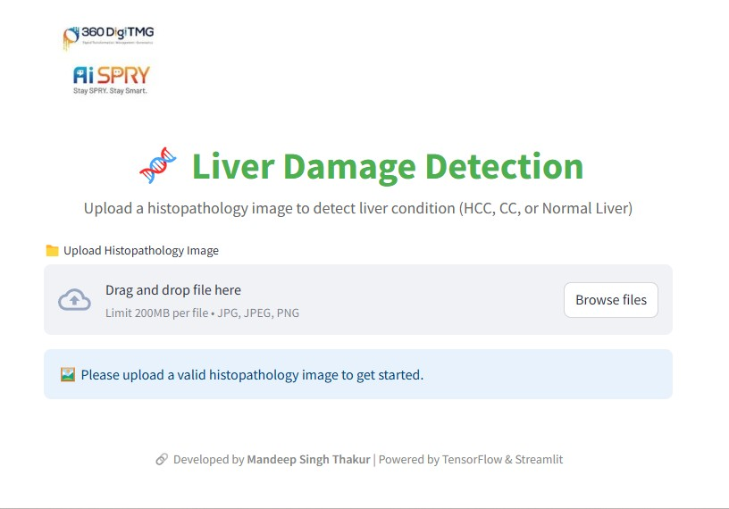
AI Predictions with a User-Friendly Interface

Slide 30
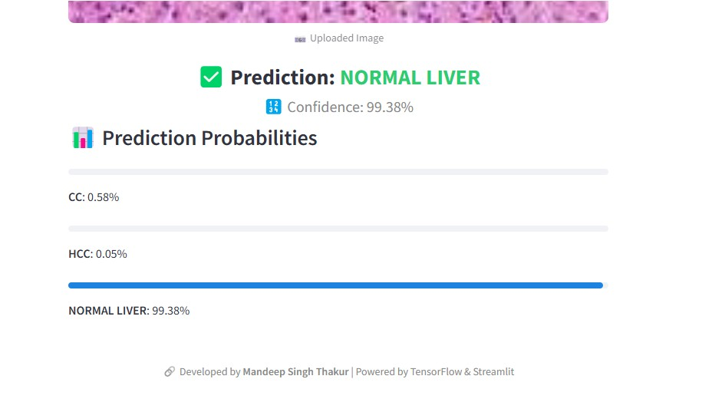
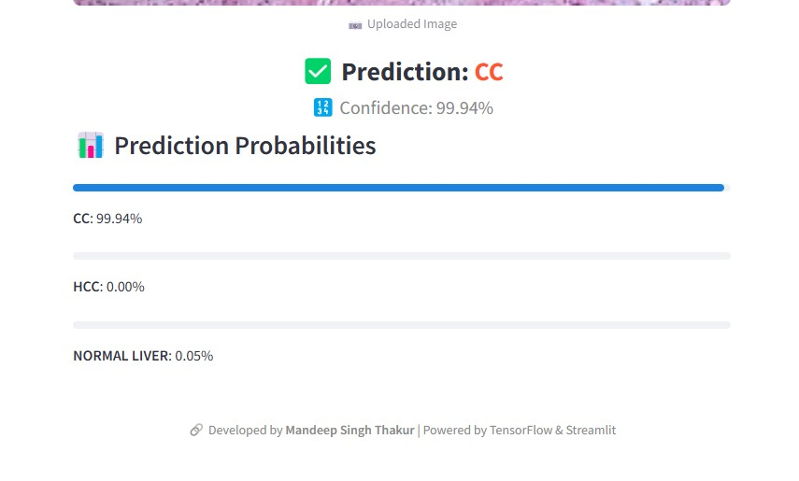
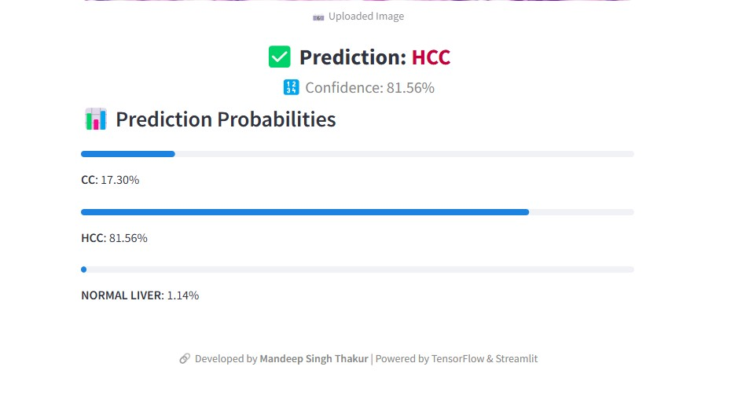
Model Prediction Performance on Liver Histopathology Images Key Points: (1) Successfully predicted all three classes: HCC, CC, and Normal Liver. (2)Achieved high prediction accuracy across the dataset used. (3)Confidence scores are very good for Normal Liver and CC images. (4) For HCC, the model predicts correctly but with slightly lower confidence compared to the other two classes when I am using random image from google. (5) Overall, the model is robust and shows strong generalization on the dataset. (6) Indicates that the model is ready for further validation and real-world deployment testing.

Slide 31
Test on Random Images:
Random testing was done on images from all three classes.
The model consistently predicted correct results, demonstrating its ability to generalize well across new images.
Reliable and Robust:
DenseNet121's performance remains consistent across different images with minimal error rates.
It is a robust solution for liver damage detection, suitable for real-world deployment.
Future Considerations:
The model can be further fine-tuned or retrained as more data becomes available.
Integration into healthcare systems could improve the speed and accuracy of liver damage detection.

Slide 32
CONCLUSION: Liver Damage Detection with AI
High Accuracy: Achieved 97% accuracy with DenseNet121, ensuring reliable predictions.
Real-Time Predictions: Deployed via Streamlit, offering instant results for uploaded histopathology images.
Robust Performance: Consistent and accurate predictions across random test images, proving the model's ability to generalize well.

Slide 33
Streamlined Diagnostics: Automates liver damage detection, reducing manual effort and assisting healthcare professionals in faster decision-making.
Real-World Impact: Can be integrated into clinical settings to improve diagnostic accuracy, reduce costs, and enhance early detection.
Future Potential: Model can be further fine-tuned and updated with more data, continuously improving its accuracy and scope.

Slide 34
PROJECT
CHALLENGES

Slide 35
Project Challenges: Liver Damage Detection (1) Limited Image Availability: Difficulty in obtaining a sufficient number of histopathology images from the provided sources. Solution: Manually downloaded images to supplement the dataset, but this was time-consuming and limited by availability. (2) Data Imbalance: The dataset had an imbalance in the number of images for each liver class (HCC, CC, NORMAL LIVER), which could impact model performance. Solution: Applied data augmentation techniques to artificially expand the dataset and balance the classes.

Slide 36
(3) Image Quality Variations: The quality and resolution of images varied, potentially affecting the model's ability to learn consistent features. Solution: Preprocessing steps like resizing, normalization, and enhancement were used to standardize the images.
(4) Computational Challenges:
Training deep learning models like DenseNet121 required significant computational resources and time.
Solution: Utilized GPU acceleration and optimized batch sizes to speed up training.

Slide 37
(5) Fine-Tuning: Fine-tuning the model for optimal performance, particularly achieving high accuracy and preventing overfitting, required a lot of experimentation with hyperparameters. Solution: Carefully monitored training progress, applied techniques like early stopping, and adjusted learning rates.

Slide 38
MONITORING & MAINTENANCE

Slide 39
1. Model Performance Monitoring Regularly track accuracy, precision, recall, and F1-score. Watch for data or model drift (changes in input data or prediction quality). 2. System Health Monitoring Monitor server uptime, latency (response speed), and resource usage (CPU, GPU). 3. Scheduled Maintenance Retrain the model every 3–6 months with fresh labeled data. Backup datasets, models, and code weekly.

Slide 40
4. Alerts & Feedback Set alerts for performance drop, system failures, or security issues. Collect doctor feedback to improve the model. 5. Security & Compliance Encrypt all patient data and ensure compliance with healthcare regulations (like HIPAA).

Slide 41

IF YOU HAVE ANY QUESTIONS OR NEED FURTHER CLARIFICATION, FEEL FREE TO ASK.
PROJECT LEAD: Muskan Momin
PRESENTED BY: Mandeep Singh Thakur

